Slide 1
CHICAGO CRIME DATASET ANALYSIS
By Nkemakolam Allen

Slide 2
INTRODUCTION
The report shows, how the analysis can help assist the Chicago PD to prevent criminal activities in the city and help reduce crime rate.
I plot graphs of some of the attributes used in this analysis. Such as; top 5 crimes in Chicago, unsafest periods in the city, arrest made in a year and district, etc.
These insights and predictions will help the Police Department make informed decisions about types of crimes to prepare for, types of crimes that occur mostly and also what periods of the day to expect these criminal acts.

Slide 3
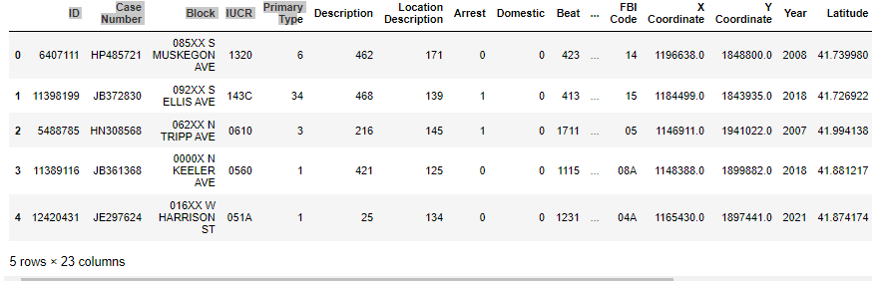
RAW DATA SET

Slide 4
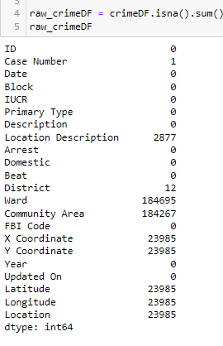
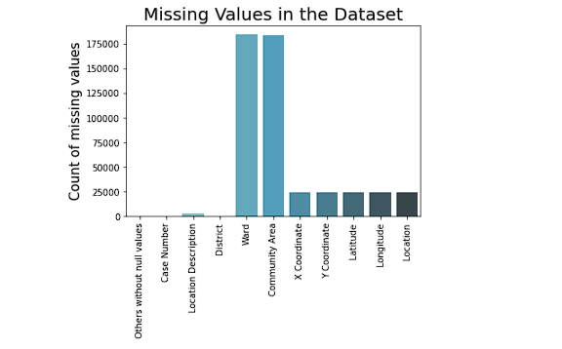
MISSING VALUES

Slide 5
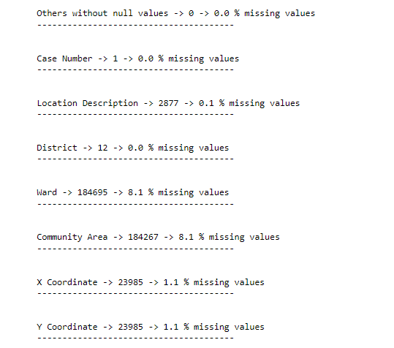
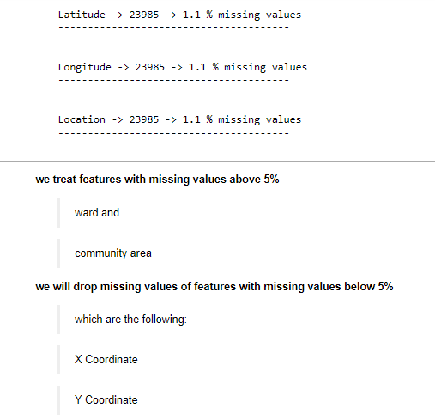
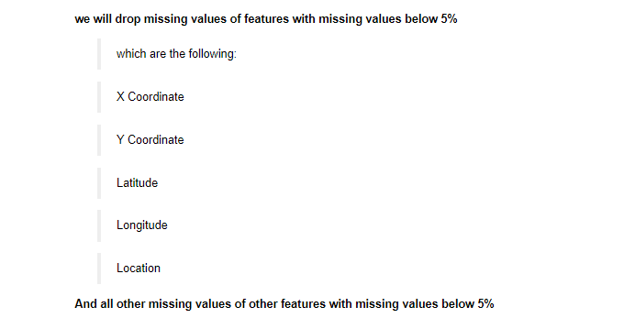
MISSING VALUES TREATMENT

Slide 6
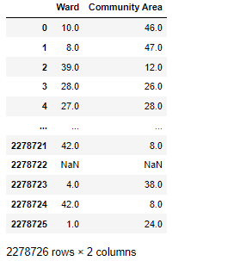
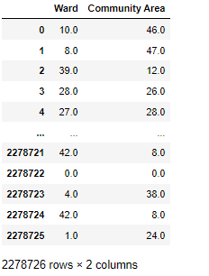
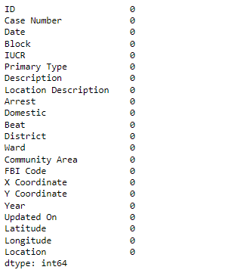

CLEAN DATASET

Slide 7
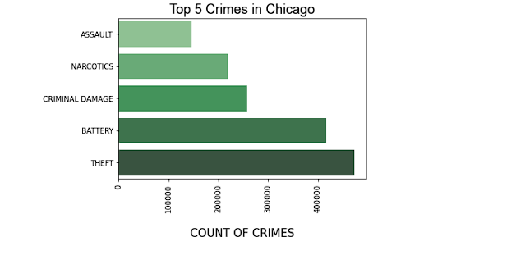
TOP 5 CRIMES IN CHICAGO
The following crime types plotted in the chart frequently occurred in Chicago city.
These are the top 5 crimes in Chicago city, with common Theft topping the count

Slide 8
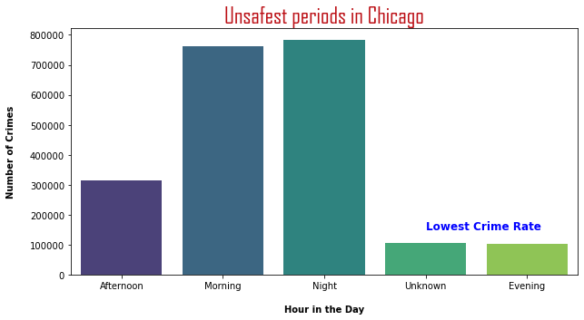
UNSAFEST PERIODS IN CHICAGO
The chart reported that the unsafe periods were mostly at early hours of the day and at late hours of the day.
It is safe to state that criminals preferred to operate at darker periods of the day.
The police can use this information to strategically deploy more man power at those periods of the day

Slide 9
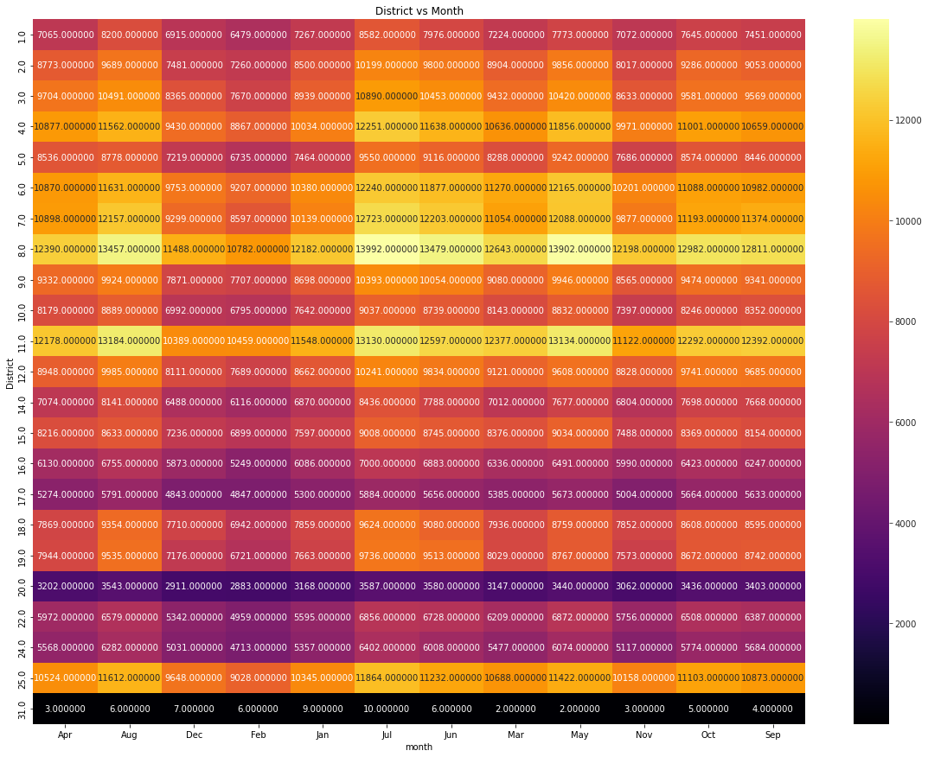
Location with higher possibility of crime
district 8 and 11 are having the highest crime rate and mostly in the months of August, July and May.

Slide 10
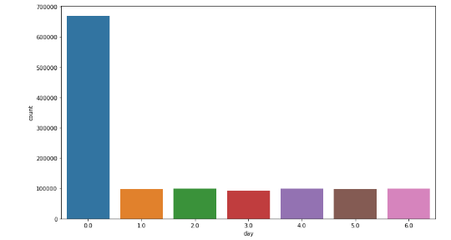
Most probable days crimes may occur
DAYS: 0 – 6
Sunday – 0
Saturday: 6
From the analysis its more likely to expect crimes on sundays than during working days

Slide 11
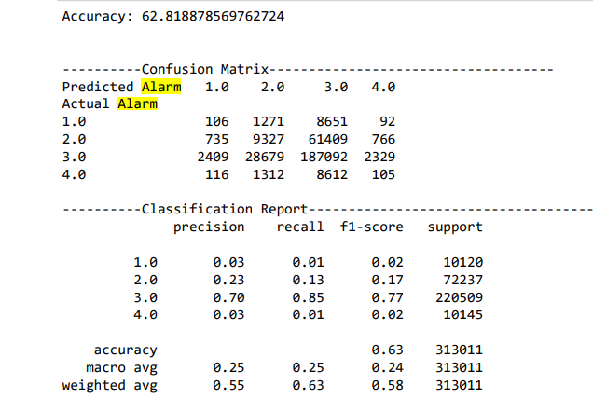
Identifying crime Hotspots
Random forest classifier

Slide 12
CONCLUSION
The crime rate in Chicago is very rampant especially in district 11and 8
Chicago crime occur mostly at darker periods of the day.
Crimes most likely to occur are Theft, battery jacking, critical damage, narcotics(drugs) and assault.
Police should deploy more man power in districts 11 and 8 and mostly at months may, July and august.
Crimes occur mostly on Sundays, than any other days.

